Slide 1
E-COMMERCE DATABASE
GROUP 11:
PRABHAT CHANDA(chanda.p@northeastern.edu)
RUCHIRKANTH GANDIKOTA(gandikota.r@northeastern.edu)

Slide 2
PROBLEM DEFINITION:
In the technologically advancing and fast-paced world, people are choosing the online shopping option over traditional window shopping due to the comfort it provides and the time it saves. E-commerce businesses like Amazon, Walmart etc. are growing exponentially due to the variety of goods and services and the ease they provide to people for choosing them over the traditional in-person stores. Even though some parts of the population are reluctant to shop online for their basic needs due to their orthodox thinking, the advantages overweigh the disadvantages which is why a majority of the people have transitioned their ways to shop following the latest trends. We aim at developing a database for an e-commerce website to store the data of customers, goods, payments, orders etc. The company will benefit in various ways, like restocking their inventory when particular goods run out, keeping a check of the payments, analysing the purchasing trends of the customers across the globe etc. Our project intends to aid the convenience of data storage for the e-commerce company with an efficiently architectured database model.

Slide 3
THEORY AND BACKGROUND:
An e-commerce company will have numerous customers ordering eclectic products online through their websites. The company will have to store data in a segregated manner and we will have to maintain dedicated databases for specific types of data so that the company can use this streamlined data to obtain valuable insights and take clear profitable business decisions.
Our project will have information about the customers. Customers will be uniquely identified by their customer id and they will also have to provide their name, phone number and address. A customer can earn benefit points depending on the amount and the frequency of their shopping, which can be redeemed later.
The data regarding products offered will be a dedicated entity type which will have different attributes like product_id(which will be uniquely identifiable), name of the product, quantity in stock and unit price.

Slide 4
The database will also have an entity type that records data about the orders that are placed by the customers. The orders will be unique by an order ID and will be linked to the customer ID attribute from the customer's entity to clearly distinguish the order placed by a respected customer. The order date, expected delivery date and the shipper ID will also be part of the orders entity.
Shippers will be a separate entity type that will contain the data about the contracted suppliers of the goods to the company. They will have a unique Shipper ID and the name of the shipper as the attributes and this data can be inherited by the other entities wherever the reference of the shippers is required.
The last entity type would be payments. They will contain information about the date, amount and mode of payment. Payment ID will be used to uniquely identify them, and a separate invoice will be generated for each payment. Each payment will then be linked to the specific customer.

Slide 5
MANDATORY REQUIREMENTS:
A customer can place many orders. An order can be placed by only 1 specific customer.
A shipper can deliver many orders. A particular order will be delivered by only 1 shipper.
A customer can generate multiple payment IDs. A particular payment ID will be generated by only 1 customer.
A particular order can contain many products. A particular product can be a part of many orders

Slide 6
EER DIAGRAM

Slide 7
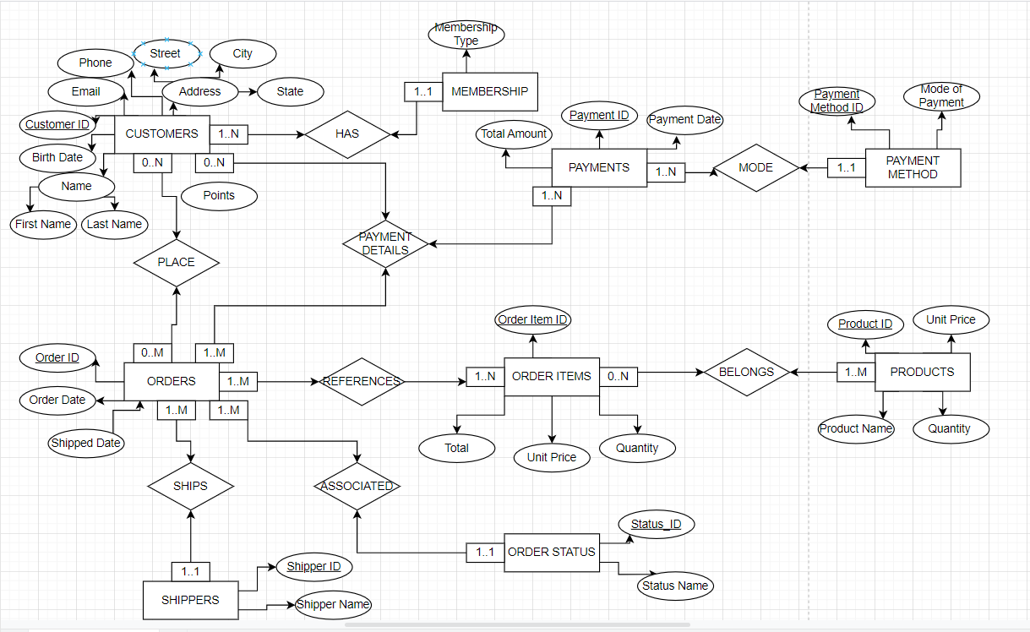

Slide 8
UML

Slide 9
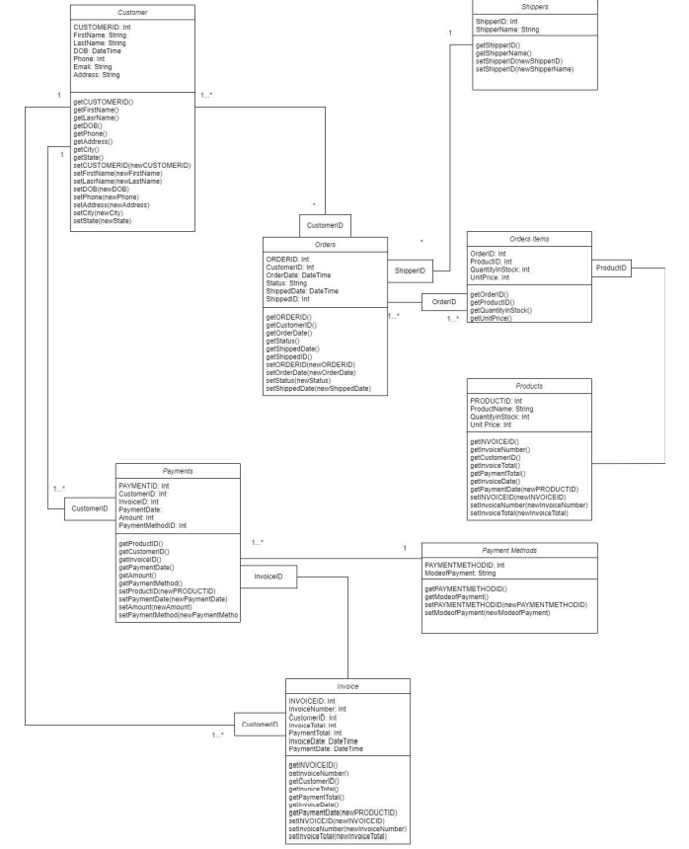

Slide 10
RELATIONAL MODEL:
(Primary Keys are UNDERLINED and Foreign Keys are in ITALICS)
Customers (Customer_ID, First Name, Last Name, Birth Date, Phone, Street Address, City, State, Points, Email)
Membership (Customer_ID, Membership Type)
Customer_ID Is the primary key and the foreign key and it refers to the primary key in the relation Customers; NULL not allowed.
Orders (Order_ID, Order Date, Status ID, Shipped Date, Shipper_ID)
Shipper_ID Is the foreign key and it refers to the primary key in the relation Shippers; NULL not allowed.
Status ID Is the foreign key and it refers to the primary key in the relation order_status; NULL not allowed.
Place (Customer_ID, Order_ID)
Customer_ID Is the foreign key and it refers to the primary key in the relation Customers; NULL not allowed.
Order_ID Is the foreign key and it refers to the primary key in the relation Orders; NULL not allowed.
Primary Key is the combination of both the above foreign keys.
Shippers (Shipper_ID, Shipper Name)

Slide 11
References (Order ID, Order Items ID)
Order Items ID Is the foreign key and it refers to the primary key in the relation Order Items; NULL not allowed.
Order ID Is the foreign key and it refers to the primary key in the relation Orders; NULL not allowed.
Primary Key is the combination of both the above foreign keys.
Belongs (Order Item ID, Product_ID)
Order Items ID Is the foreign key and it refers to the primary key in the relation Order Items; NULL not allowed.
Product_ID Is the foreign key and it refers to the primary key in the relation Products; NULL not allowed.
Primary Key is the combination of both the above foreign keys.
Order Items (Order Item ID, Product_ID, Quantity, Unit Price, Total)
Product_ID Is the foreign key and it refers to the primary key in the relation Products; NULL not allowed.
Products (Product_ID, Product Name, Quantity in Stock, Unit Price)
Payment Method (Payment Method ID, Mode of Payment)

Slide 12
Payments (Payment ID, Payment Date, Total Amount, Payment Method ID)
Payment Method ID Is the foreign key and it refers to the primary key in the relation Payment Method; NULL not allowed.
Order_Payments_Details (Customer_ID, Order_ID, Payment_ID)
Customer_ID Is the foreign key and it refers to the primary key in the relation Customers; NULL not allowed.
Order_ID Is the foreign key and it refers to a key in the relation Orders; NULL not allowed.
Payment_ID Is the foreign key and it refers to the primary key in the relation Payments; NULL not allowed
Order_Status(Status_ID, Status Name)

